Slide 1
Using Motivational Interviewing to Address Risky Alcohol Use in Older Adults
July 22, 2019
Presented by:
Michelle Dattada, MSW, LCSW
Woodrina Layton, LPC, NCC

Slide 2
Learning Objectives
Participants will gain an understanding of the impact of risky alcohol use on health outcomes for older adults
Participants will gain an understanding of how to use motivational interviewing skills to discuss risky alcohol use
Participants will utilize skills in responding to real life scenarios with reduced resistance and increased engagement in effective strategizing

Slide 3
Aging in America
Source: https://agingstats.gov/images/olderamericans_agingpopulation.pdf

Slide 4
Alcohol Use in Older Adults
Notes:
In conversation about widowers, focus on sharing supplemental information on loneliness and health risks

Slide 5
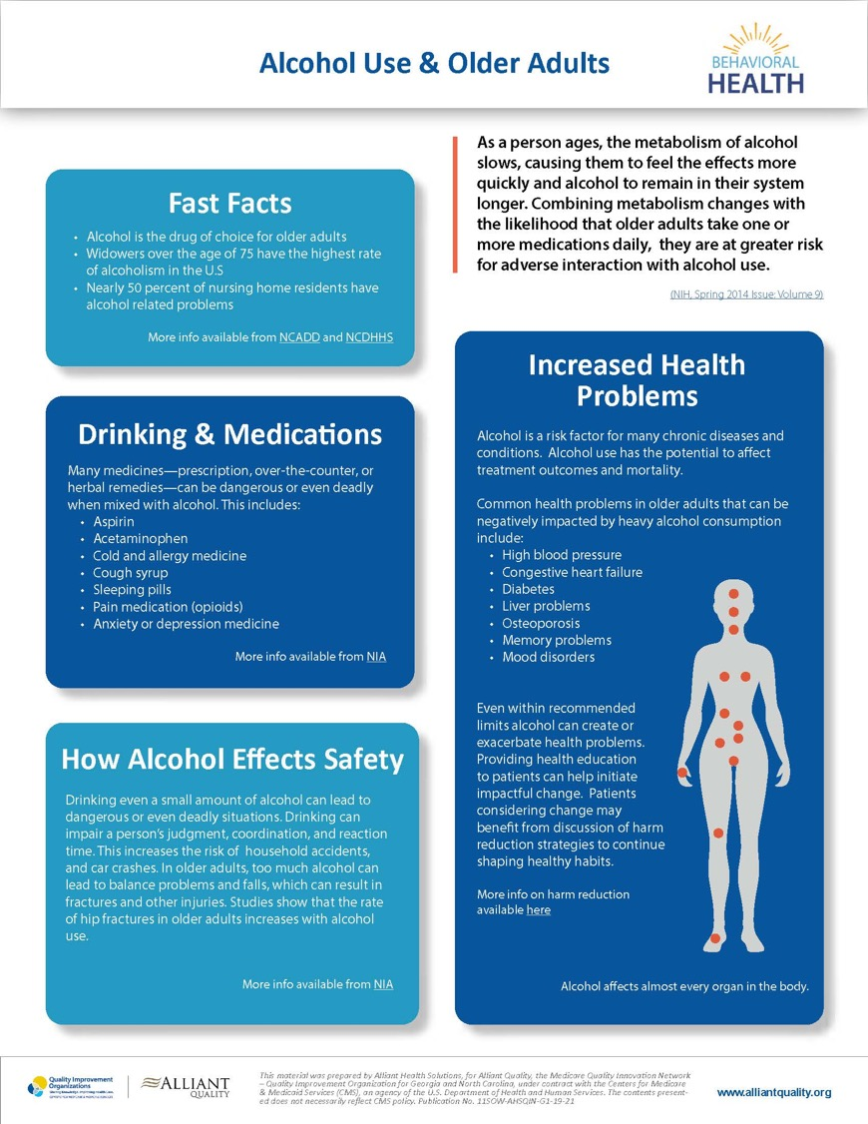
6% of alcohol poisoning deaths each year are adults age 65+
More patients age 65+ are admitted to hospitals for alcohol problems than for heart attacks
6-11% of elderly hospital admissions are a result of alcohol or drug problems:
14% of elderly emergency room admissions
20% of elderly psychiatric hospital admissions

Slide 6
Risky Alcohol Use
Drinking more than these single-day or weekly limits is considered "at-risk" or "heavy" drinking:
Women: More than 3 drinks on any day or 8 per week
Men: More than 4 drinks on any day or 15 per week
Day:
Week:
Day:
Week:

Slide 7
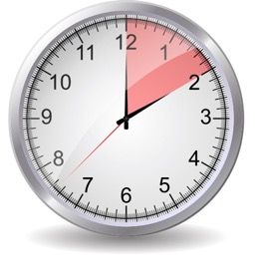
Binge Drinking
Binge drinking is a pattern of drinking that brings blood alcohol concentration (BAC) levels to 0.08 g/dL.
This typically occurs in a two-hour time span after 4 drinks for women and 5 drinks for men.

Slide 8
Health Outcomes

Slide 9
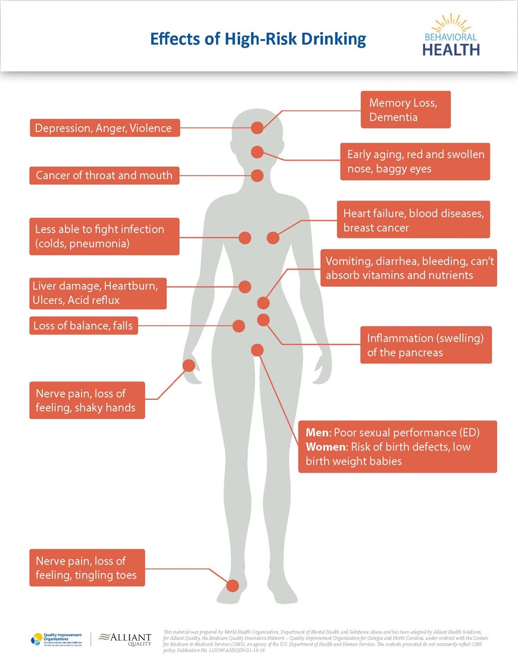
Source: https://apps.who.int/iris/bitstream/handle/10665/67210/WHO_MSD_MSB_01.6b.pdf
Source: https://www.alliantquality.org/?q=content/behavioral-health
Notes:
Increase depression and anxiety
Increase risk of strokes
Decrease bone density
Can worsen osteoporosis, diabetes
Leads to some kinds of cancer, liver damage, immune system and brain damage
Can worsen osteoporosis
Accelerated brain aging, particularly in the frontal lobe

Slide 10
Older Adults and Alcohol
Decreased tolerance, faster effects
The body’s ability to break down alcohol is slowed and remains in the person’s system longer
Balance problems and falls increases fracture risks
With alcohol use and driving, older adults tend to be more seriously hurt in crashes than others
Older women are more sensitive to effects than older men
Older adults have increased comorbid health conditions and are prescribed multiple medications
Notes:
Ie. changes in heart and vessels may dull pain that might be a sign of heart attack

Slide 11
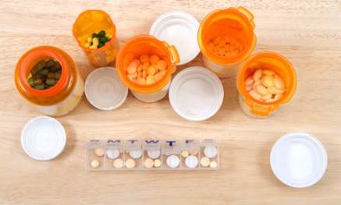
Medication Interactions
Allergies
Cold/Flu
Cough
Depression
Diabetes
Sleeping aids
High Cholesterol
Muscle Relaxers
High Blood Pressure
Opioids and benzodiazepines
Notes:
The medications listed here should never be mixed with alcohol. Impact liver, breathing difficulties. It is estimated that 1 in 4 older adults may be adversely affected by combining alcohol and medications. Six to eleven percent of elderly hospital admissions are a result of alcohol or drug problems — 14 percent of elderly emergency room admissions. Therefore awareness is very important and discussing alcohol consumption with your physician is critical.

Slide 12
Screening & Brief Face-to-Face Counseling

Slide 13
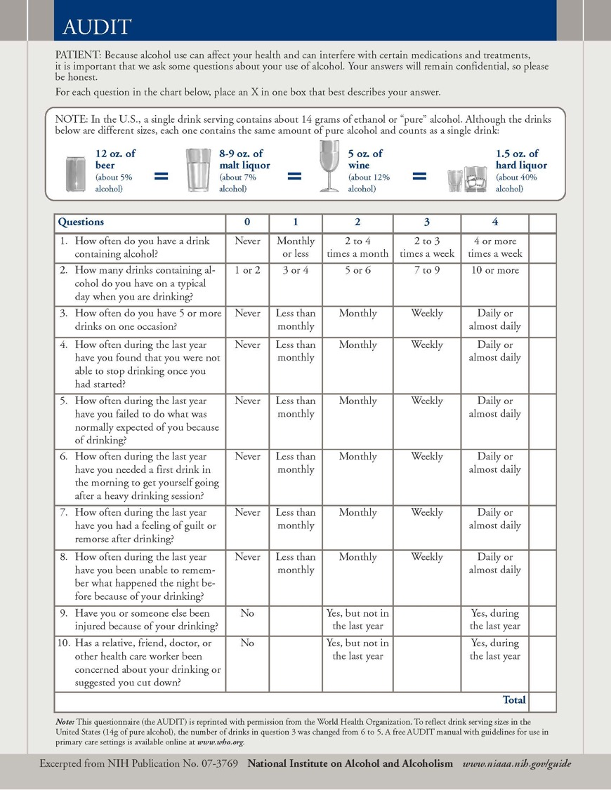
The Alcohol Use Disorders Identification Test
AUDIT is a 10-item screening tool used to assess alcohol consumption, drinking behaviors, and alcohol-related problems.
The AUDIT can be administered by a clinician or done as a self report.
https://www.alliantquality.org/?q=content/tools
https://www.communitycarenc.org/sites/default/files/sbirt-audit-forms.pdf
https://pubs.niaaa.nih.gov/publications/Audit.pdf

Slide 14
Brief Face-to-Face Counseling
Positive screen result
Up to four (4), brief, face-to-face behavioral counseling interventions per year
Medicare beneficiaries
Includes pregnant women
Counseling furnished by a qualified primary care physician or other primary care practitioner in a primary care setting.

Slide 15
Criteria for Use
Patients are competent and alert at the time that counseling is provided
For those who misuse alcohol, but whose levels or patterns of alcohol consumption do not meet criteria for alcohol dependence as defined by at least three of the following:
Tolerance
Impaired Control
Preoccupation with acquisition and/or use
Sustains social, occupational or recreational disability
Withdrawal
Persistent desire or unsuccessful efforts to quit
Use continues despite adverse consequences

Slide 16
Billing Codes
Billing Code | Code Name | Description
G0444 | Annual Depression Screening | Can be billed annually; meaning 11 full months must elapse following the month in which the last annual depression screen occurred. This visit can take up to 15 minutes to complete.
G0442 | Annual Alcohol Misuse Screening | Can be billed annually. This visit can take up to 15 minutes to complete.
G0443 | Counseling for Alcohol Misuse | Brief face-to-face behavioral counseling for alcohol misuse. This visit can take 15 minutes to complete and can be provided four (4) times per year.
G0402 | “Welcome to Medicare” Visit | Beneficiaries must receive this service within the first 12 months after the effective date of the Medicare Part B enrollment. Alcohol misuse screening (G0442) can be billed with this service. Depression screening (G0444) is not payable with this service; as it is included.
G0438 | Medicare Annual Wellness Visit | Limited to beneficiaries not within 12 months after the effective date of their first Medicare Part B coverage period and have not received an IPPE within the past 12 months. May be billed once in a a lifetime for eligible beneficiaries. Alcohol misuse screening (G0442) may be billed with this service. Depression screening (G0444) is not payable with this service.
G0439 | Medicare Annual Wellness Visit (subsequent visit) | Valid to beneficiaries who have not received an Annual Wellness Visit (AWV) within the past 12 months. This service may be billed once per year. Alcohol (G0442) and Depression (G0444) Screenings may be billed with this service.
G8431 | Positive Depression Screen | Position screen for clinical depression using an age appropriate standardized tool. A follow up plan must be documented.
G8510 | Negative Depression Screen | Negative screen for clinical depression using an age appropriate standardized tool.

Slide 17
MIPS Quality Measure: Alcohol
Quality Measure | Description | Reporting Details
Preventive Care and Screening: Unhealthy Alcohol Use: Screening and Brief Counseling (G0442 annual alcohol misuse, G0443 brief face to face) | Percentage of patients aged 18 years and older who were screened for unhealthy alcohol use using a systematic screening method at least once within the last 24 months AND who received brief counseling if identified as an unhealthy alcohol user. | Type: Process Data Submission Methods: R Screening Tool: AUDIT

Slide 18
MIPS Quality Improvement Activity
Unhealthy alcohol use: Regular engagement of MIPS eligible clinicians or groups in integrated prevention and treatment interventions, including screening and brief counseling for patients with co-occurring conditions of behavioral or mental health conditions.

Slide 19
Motivational Interviewing

Slide 20
What is Motivational Interviewing (MI)?
A set of specific techniques combined with a specific style, or way of being, with a patient
An evidence-based approach designed to mobilize patients’ internal resources for change
Focused on responding to resistance
Experiencing denial

Slide 21
Why Do We Need MI?
It doesn't matter what reasons we give patients that they should change.
or how much we want them to,
lasting change is more likely to occur
when they discover their own reasons and determination to change.

Slide 22
Stages of Change
Pre-contemplation
Action
Contemplation
Maintenance
RELAPSE

Slide 23
Motivation
A person’s stage of readiness for change
Malleable – it’s dynamic and fluctuating
Modifiable – it can be nurtured or hampered
Affected by external factors
Particularly sensitive to interpersonal interactions with people in our lives who we consider to be influential

Slide 24
MI Principles
Express empathy with a warm, non-judgmental approach, active listening and reflecting back
Develop discrepancy between how they want their life to be and how it is now
Roll with resistance, use this energy to support change potential
Support self-efficacy and autonomy with confidence and connection to accomplishment and ability

Slide 25
MI Basics
Spirit
Change Talk
Communication Skills: OARS
Readiness Ruler
Planning

Slide 26
Achieving the Spirit of MI as a Healthcare Professional
Standard Way
Sharing expertise
Giving advice
Providing directives
Setting expectations
Warning against unhealthy practices
MI Practice
Asking permission to give advice or information
Inviting patients to disregard advice or information if they choose
Allowing patients to decide
Acknowledging patients’ autonomy
Responding with empathy and acceptance

Slide 27
Continuum of Styles
Directing Guiding Following
Match These:
Allow
Govern
Motivate
Run
Lead
Encourage
Take along
Show
Listen
Shadow
Kindle
Prescribe
Tell
Be with
Command
Take in

Slide 28
Change Talk
Words that a person uses to make their own argument for change
Words that give voice to one’s motivation
Words that describe someone’s Desires, Abilities, Reasons, Need to change (DARN)
The opposite of Change Talk is “Sustain Talk”

Slide 29
Can you Hear the Change Talk?

Slide 30
Strategies for Evoking Change Talk
Ask open ended questions:
Ask for elaboration:
Ask for examples:
Look back:
Look forward:
Query Extremes:
Explore Goals & Values:
Why would you do this?
In what ways would it be different this time?
What happened when you quit last time?
How were things better/different before you started?
What if things continue as they are?
What’s the worst/best thing to happen if you make this change?
What is the most important reason for you to do this?

Slide 31
Core Interviewing Skills
OARS
Open-ended questions
Affirming
Reflecting
Summarizing
Providing Information and Advice with Permission

Slide 32
OARS: Open-ended Questions
Generate more response from the patient
Allow the patient to choose how to respond
Give us more insight into patient’s perspective
Open-Ended Question:
“What negative consequences have you experienced as a result of your drinking?”
Instead of:
“Have you experienced negative consequences from drinking?”

Slide 33
OARS: Affirmations
Emphasize patients’ strengths, abilities, and positive qualities; they must believe they can be successful
Are very different from praise or encouragements
Are most effective when they highlight a specific behavior or quality, and often include the word “you”
Affirmative:
“You have been consistent with your meds in the past and are really trying to figure out how to get back to that place.”
Instead of:
“You are so smart, and you know taking your medication is what’s best for you even with the side effects.”

Slide 34
OARS: Reflections
Are statements made by helping professionals to convey their understanding of what the patient means
Prevent misunderstanding to promote understanding*
Allow people to see themselves and their lives through different eyes
Are more effective than questions in promoting a more authentic and natural response in patients
* When people feel understood, they are more likely to make change

Slide 35
OARS: Summarizations
A combination of reflections
Reviewing a paragraph of patient’s words
“Stringing the pearls”

Slide 36
Importance/Confidence Ruler
“On a scale of 0 to 10, how important is it for you to stop drinking?”
Not Ready |  |  |  | Unsure |  |  |  | Ready
0 | 1 | 2 | 3 | 4 | 5 | 6 | 7 | 8 | 9 | 10
Pre-contemplation; early contemplation |  |  |  | Contemplation |  |  |  | Preparation; action
“And, why are you a 6 and not a 3?”

Slide 37
Signs of Readiness for Planning
Increased change talk
Taking steps
Diminished sustain talk
Recognition of person’s resolve
Statements that envision the change occurring
Questions about change

Slide 38
Planning
Evoking activation talk
Asking for commitment
Get the WHO, WHEN,HOW and WHY
Goal Setting: Specific, Measurable, Attainable, Relevant, Time-Bound (SMART)
Troubleshoot

Slide 39
Guiding Questions for MI
Why would you want to make this change?
If you decide to make this change, how might you go about it?
What are the three best reasons for you to make this change?
How important is it for you to make this change?
What do you think you’ll do?

Slide 40
Case Study
Chester is an 89-year-old African American male who lives alone. He is diagnosed with COPD and diabetes and has recently experienced a fall in which he fractured his arm. He reports that he drinks 5-6 cans of beer per evening. He identifies prior issues with alcohol use for approximately a 5-year period when he was in his 20’s. He did not receive any treatment at that time and is not interested in making any changes to his current use. He denies any issues at this time.

Slide 41
“When a person feels accepted for who they are and what they do – no matter how unhealthy or destructive – it allows them the freedom to consider change rather than needing to defend against it.”
~William R. Miller

Slide 43
Michelle Dattada, MSW LCSW – Technical Advisor
O: 919-695-8327
michelle.dattada@alliantquality.org
Woodrina Layton, LPC, NCC
Technical Advisor
O: 678-527-3636
woodrina.layton@alliantquality.org
For more information about the Motivational Interviewing Network of Trainers, please visit: https://motivationalinterviewing.org/about_mint

Slide 44
References
https://pubs.niaaa.nih.gov/publications/Medicine/Harmful_Interactions.pdf
https://www.cms.gov/Outreach-and-Education/Medicare-Learning-Network-MLN/MLNMattersArticles/downloads/MM7633.pdf
https://www.nia.nih.gov/health/facts-about-aging-and-alcohol
https://www.niaaa.nih.gov/alcohol-health/special-populations-co-occurring-disorders/older-adults
https://niaaa.scienceblog.com/103/alcohol-and-the-aging-brain/
https://www.ncdhhs.gov/divisions/mhddsas/olderadults/older-adults-and-substance-use-disorder
https://www.cdc.gov/vitalsigns/alcohol-poisoning-deaths/infographic.html#infographic
https://www.ncadd.org/index.php/about-addiction/seniors/alcohol-drug-dependence-and-seniors?highlight=WyJhZHVsdHMiLCJhbGNvaG9sIiwib2xkZXIiXQ==
https://www.cms.gov/Outreach-and-Education/Medicare-Learning-Network-MLN/MLNMattersArticles/downloads/MM7633.pdf
www.samhsa.gov
www.medicare.gov
Miller, William R & Rollnick, Stephen (2013) Motivational Interviewing Helping People Change (3rd ed.).
https://www.rethinkingdrinking.niaaa.nih.gov/Thinking-about-a-change/
http://www.aa.org/
https://www.smartrecovery.org/

Slide 45
This material was prepared by Alliant Quality, the Medicare Quality Innovation Network - Quality Improvement Organization for Georgia and North Carolina, under contract with the Centers for Medicare & Medicaid Services (CMS), an agency of the U.S. Department of Health and Human Services. The contents presented do not necessarily reflect CMS policy. Publication No. 11SOW-AHSQIN-GA-G1-19-05

