Slide 1
Identifying and Addressing Malnutrition in Older Adults:
A Social Model Approach
Allison Bernal, RDN, LD
Manager, DHS DAS Livable Communities Section
Renae Brown, MS, RD, LD
Chief Dietitian/Nutritionist, DHS DAS Livable Communities Section
Notes:
Need to use updated PPT…

Slide 2
Division of Aging Services
Notes:
Need to Use Update PPT

Slide 3

Overview
Malnutrition Diagnosis
Causes of Malnutrition
Cost of Malnutrition
A Social Model Approach to Malnutrition
Social Model Work in Georgia
Future Directions
Division of Aging Services

Slide 4
Malnutrition diagnosis
Two or more of the following six characteristics:
Insufficient energy intake
Weight loss (unintentional)
Loss of muscle mass
Loss of subcutaneous fat (under skin, in thighs, buttocks)
Localized or generalized fluid accumulation that may sometimes mask weight loss
Diminished functional status as measured by handgrip strength
Possible to assess in
non-clinical or community setting
White et al., AND, ASPEN, Consensus Statement Adult Malnutrition, 2012, http://journals.sagepub.com/doi/pdf/10.1177/0148607112440285
Division of Aging Services
Notes:
Malnutrition is considered a state of deficit, excess, or imbalance in protein, energy, or other nutrients that adversely impacts an individual’s own body form, function, and clinical outcomes
For many older adults, lack of adequate protein and loss of lean body mass are particularly significant problems, including for those who may be overweight or obese.
The importance of malnutrition prevention for older adults is magnified as it affects independent living, healthy aging, and the severity of chronic conditions and disabilities.1
Malnutrition, particularly the lack of adequate protein, calories, and other nutrients needed for tissue maintenance or repair, has been shown to be associated with poor health outcomes, frailty and disability, and increased healthcare costs. Importantly, malnutrition is a significant problem for both underweight and overweight or obese individuals due to loss of lean body mass.
https://www.defeatmalnutrition.today/sites/default/files/documents/MQC_Blueprint_web.pdf
Poverty and food insecurity significantly increase the risk of malnutrition. At the same time, there are other risk factors to consider as well. Changes commonly associated with aging, such as loss of appetite, limited ability to chew or swallow, and use of multiple medications, can impact diet and nutrition
Mention nutrition focused physical exam

Slide 5
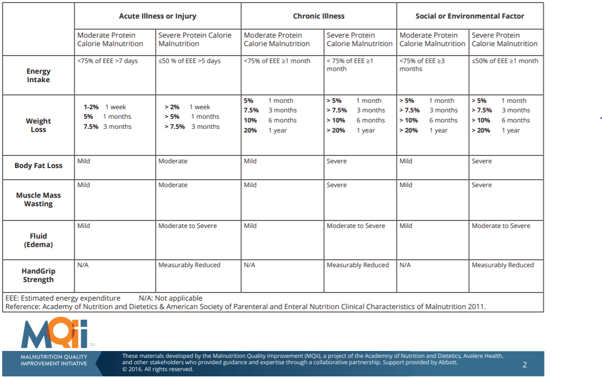
Malnutrition diagnosis
Division of Aging Services

Slide 6
Malnutrition diagnosis
Division of Aging Services

Slide 7
Malnutrition Occurs in Different Contexts
Acute
illness or injury
Chronic
illness
Social or environmental circumstances
Malnutrition
Snider J.T., Linthicum M.T., Wu Y., LaVallee C., Lakdawalla D.N., Hegazi R., Matarese L. Economic Burden of Community-Based Disease-Associated Malnutrition in the United States. JPEN J. Parenteral. Enteral Nutr. 2014;38:77S–85S. doi: 10.1177/0148607114550000.
Division of Aging Services
Notes:
Acute (surgery/stomach flu)
Chronic illness (cancer, crohn’s disease (body does not absorb nutritions properly), ulcerative colitis, celiac disease, alcoholism, mental health problems (dementia)
The causes of malnutrition are multiple and complex, and the solutions will require collaboration among many organizations, government bodies, and communities. To coalesce the key stakeholders and focus additional attention on older adult malnutrition, the Defeat Malnutrition Today coalition (www.defeatmalnutrition.today) has led the development of this National Blueprint: Achieving Quality Malnutrition Care for Older Adults (Blueprint) https://www.defeatmalnutrition.today/sites/default/files/documents/MQC_Blueprint_web.pdf

Slide 8
Malnutrition is a Critical Public Health and Safety Issue
Malnutrition
Leads to poorer health outcomes
Leads to frailty and disability
Advancing Policies for Quality Malnutrition Care in Older Adults, 2017, http://www.defeatmalnutrition.today/sites/default/files/documents/2017%20Malnutrition%20Legislative%20Toolkit_PRINT.pdf
Division of Aging Services
Notes:
Further, with disease-associated malnutrition, inflammatory responses are increased, which can result in decreased appetite, gastrointestinal problems, diminished immune response, delayed wound healing, and increased infection rates. Such changes can increase risks for functional disability, frailty, and falling. https://www.defeatmalnutrition.today/sites/default/files/documents/MQC_Blueprint_web.pdf

Slide 9

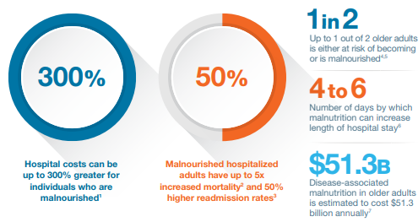
Advancing Policies for Quality Malnutrition Care in Older Adults, 2017, http://www.defeatmalnutrition.today/sites/default/files/documents/2017%20Malnutrition%20Legislative%20Toolkit_PRINT.pdf
Division of Aging Services

Slide 10
Advancing Policies for Quality Malnutrition Care in Older Adults, 2017, http://www.defeatmalnutrition.today/sites/default/files/documents/2017%20Malnutrition%20Legislative%20Toolkit_PRINT.pdf
Division of Aging Services
Notes:
Disease-associated malnutrition (DAM) is malnutrition that occurs from disease-related causes. This is different from malnutrition caused by lack of availability of food. In patients with DAM, nutrient intake is diminished and inflammatory responses increase [1], inducing increased metabolic demand, decreased appetite, gastrointestinal problems, and difficulty chewing and swallowing, all of which can decrease lean body mass and increase the risks of complications during treatment of the primary disease [2]. Increased inflammatory responses also diminish immune response, increasing infection rates, decreasing muscle strength, retarding wound healing, and reducing physical function [3]. Collectively these factors increase risks for functional disability, frailty, and falling [4].
Source: Economic Burden of Disease-Associated Malnutrition https://www.ncbi.nlm.nih.gov/pmc/articles/PMC5031313/

Slide 11
Cost of disease-associated malnutrition in Georgia?
Georgia’s annual costs in 65+ are $99/person and
more than
$125 million/yr
Advancing Policies for Quality Malnutrition Care in Older Adults, 2017, http://www.defeatmalnutrition.today/sites/default/files/documents/2017%20Malnutrition%20Legislative%20Toolkit_PRINT.pdf
Division of Aging Services

Slide 12
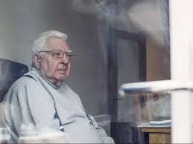


What does malnutrition look like?
Image Sources:
Toews, K. (2016, June 08). Seniors malnutrition: A national crisis. https://chefsforseniors.com/blog/2016/6/7/g4zrsvmxjt2g0u8edhbechdfdo50n3
Senior citizen black images. https://www.shutterstock.com/search/senior citizen black?search_source=base_keyword&ref_context=keyword
Cohut, M. (2018, May 08). Are people with diabetes, obesity predisposed to stress?. https://www.medicalnewstoday.com/articles/321743.php
Division of Aging Services

Slide 13
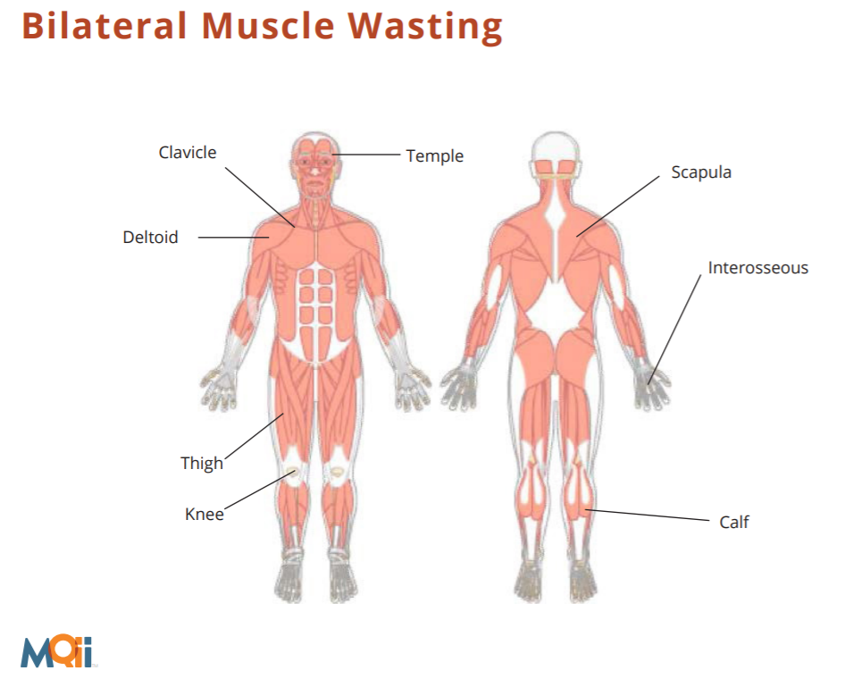
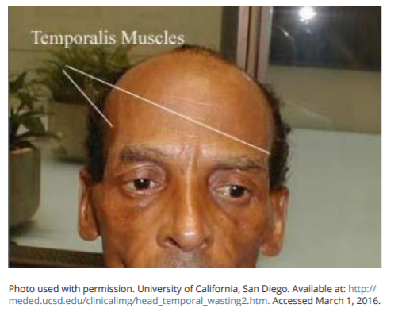
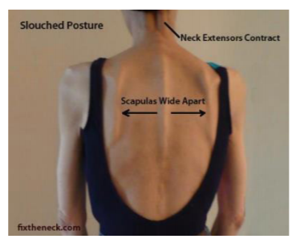
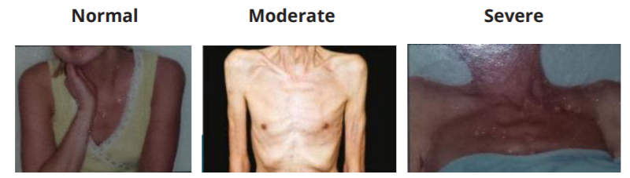
Nutrition Focused Physical Exam: Macronutrient Deficiencies
Malnutrition Quality Improvement Initiative Malnutrition Recognition Guide. http://malnutrition.com/static/pdf/mqii-malnutrition-recognition-guide.pdf
Division of Aging Services

Slide 14
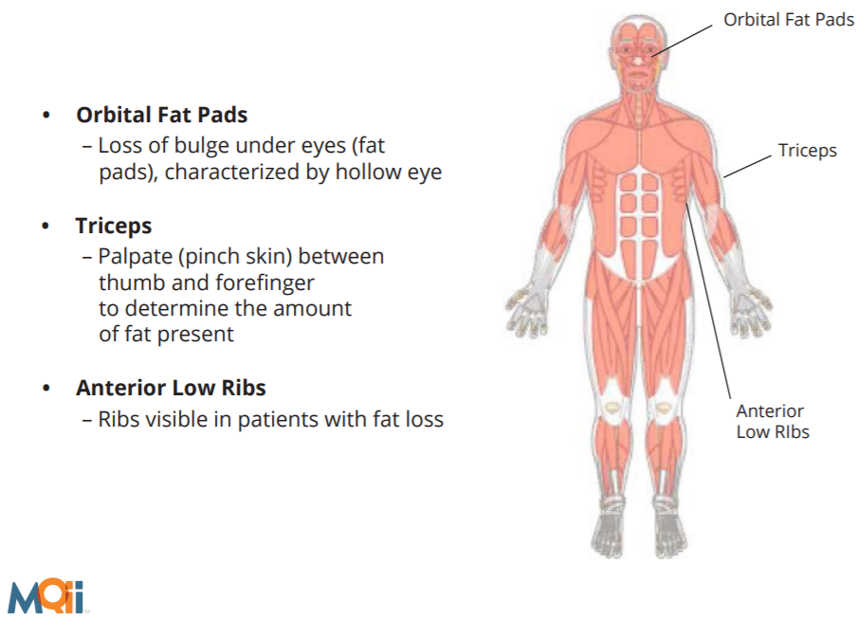

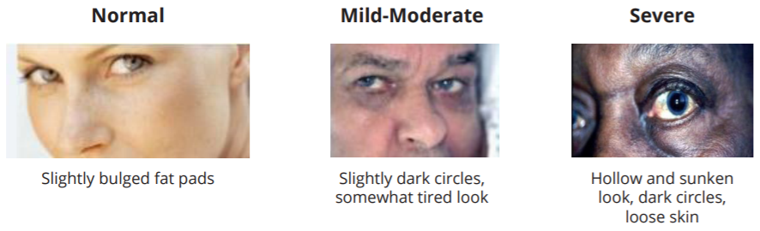
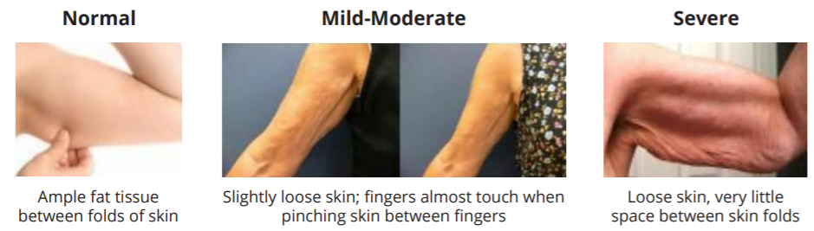
Nutrition Focused Physical Exam: Macronutrient Deficiencies
Malnutrition Quality Improvement Initiative Malnutrition Recognition Guide. http://malnutrition.com/static/pdf/mqii-malnutrition-recognition-guide.pdf
Division of Aging Services

Slide 15
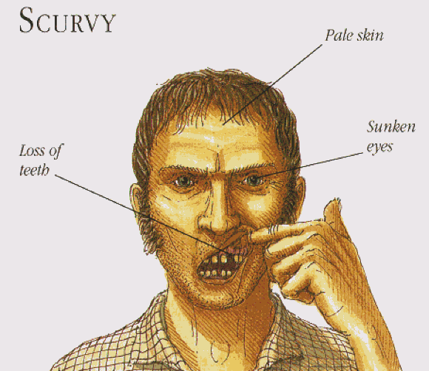
Nutrition Focused Physical Exam: Micronutrient Deficiencies
Signs | Possible Nutrition-Related Causes | Possible Non-Nutrition-Related Causes
Hair (corkscrew hair) | Vitamin C deficiency | Menkes syndrome
Eyes (pale conjunctiva) | Vitamin B6, B12, Folate, Iron, Copper deficiency, anemias | Non-nutritional anemia
Face (pallor) | Iron, Folate, Vitamin B12, Vitamin C deficiency
Gums (gingivitis, swollen, red) | Vitamin C, Niacin, Folate, Zinc, Vitamin D deficiency, excessive Vitamin A | Poor oral hygiene, smoking, pregnancy, diabetes
Black, A. (2013, May 02). Scurvy: By the End, Death is a Mercy. https://www.atlasobscura.com/articles/scurvy
Academy of Nutrition and Dietetics. Micronutrient Exam: Clinical Interpretation of Nutrition Focused Physical Exam Findings. (n.d.). https://www.todaysdietitian.com/newarchives/images/MicronutrientTable0318.pdf
Division of Aging Services

Slide 16
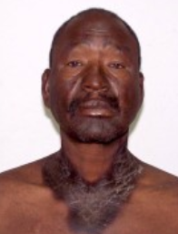
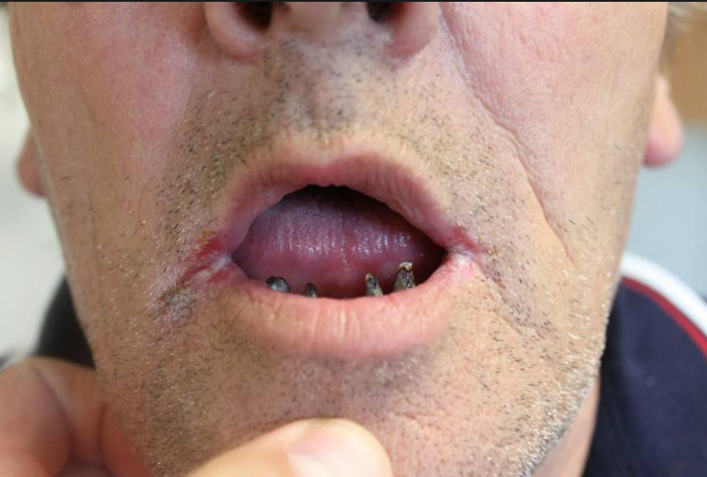
Nutrition Focused Physical Exam: Micronutrient Deficiencies
Signs | Possible Nutrition-Related Causes | Possible Non-Nutrition-Related Causes
Skin (hyperpigmentation) | Niacin deficiency | Hormonal changes, sun exposure, meds
Mouth (angular cheilitis) | Riboflavin, Niacin, Iron, B6, B12 deficiency, Vitamin A toxicity | Ill-fitting dentures, dry skin, herpes
Lips (soreness, burning) | Riboflavin deficiency
Taste (altered/diminished) | Zinc deficiency | Meds
Nails (spoon-shaped) | Iron, protein deficiency, anemia | Diabetes, Raynaud’s disease, hypothyroidism
Pellegra. American Osteopathic College of Dermatology. https://www.aocd.org/page/Pellagra
Angular cheilitis (syn. angular stomatitis). http://www.pcds.org.uk/clinical-guidance/angular-chelitis
Academy of Nutrition and Dietetics. Micronutrient Exam: Clinical Interpretation of Nutrition Focused Physical Exam Findings. (n.d.). https://www.todaysdietitian.com/newarchives/images/MicronutrientTable0318.pdf
Division of Aging Services
Notes:
Raynaud's disease is a rare disorder of the blood vessels, usually in the fingers and toes. It causes the blood vessels to narrow when you are cold or feeling stressed. When this happens, blood can't get to the surface of the skin and the affected areas turn white and blue.

Slide 17
Once malnutrition is identified, how can it be addressed?
Division of Aging Services

Slide 18
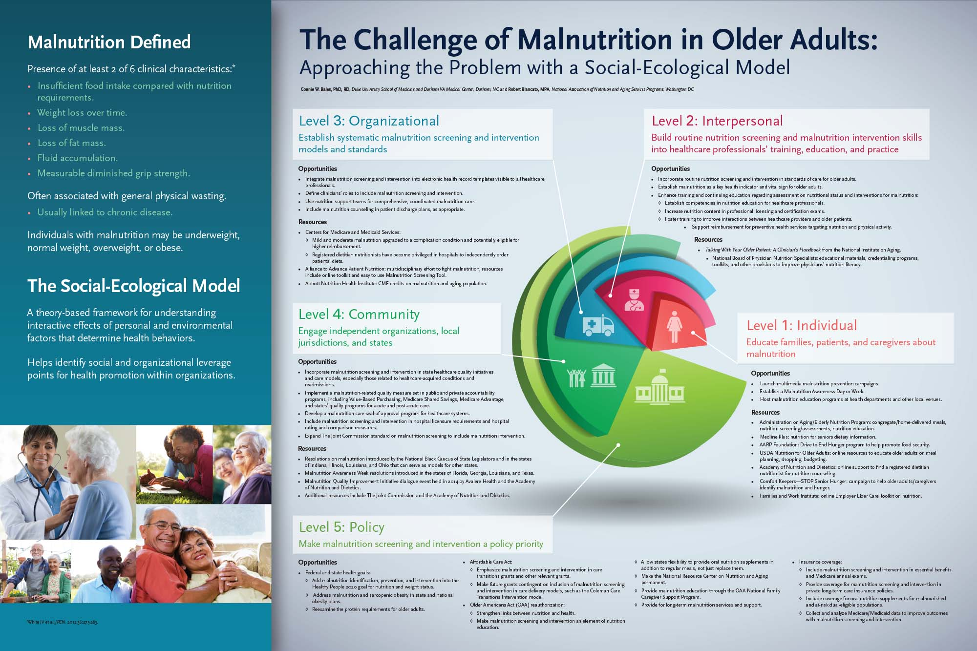



Current Initiatives
Assistive Technology
Senior Hunger
High Performing Congregate Nutrition Programs/What a Waste
ADRC Healthy Communities Summit
Division of Aging Services

Slide 19
Level 1: Individual
Educate families, patients and caregivers about malnutrition
Opportunities and Resources
Launch malnutrition prevention campaign | AARP Foundation: Drive to End Hunger Program
Establish a Malnutrition Awareness Day or Week | USDA Nutrition for Older Adults
Host malnutrition education programs | STOP Senior Hunger – campaign to help identify malnutrition and hunger
Georgia’s work: Utilize Registered Dietitian expertise in senior centers for monthly nutrition education
Division of Aging Services
Notes:
Malnutrition Awareness Week Sept 23-27, 2019 (ASPEN: American Society for Parenteral and Enteral Nutrition)

Slide 20
Level 2: Interpersonal
Build routine malnutrition screening and intervention skills into healthcare professional training, education and practice.
Opportunities
Incorporate routine nutrition screening and intervention standards | Establish malnutrition as a key health indicator and vital sign for older adults
Increase nutrition content in professional licensing and certification exams | Foster training to improve interactions between healthcare providers and older patients
Georgia’s work: Update trainings for Nutrition Screening Initiative, Food Security Survey to improve accuracy of assessments
Division of Aging Services

Slide 21
Level 3: Organizational
Establish systematic malnutrition screening and intervention models and standards.
Opportunities
Integrate malnutrition screening and intervention into EMR | Use nutrition support teams for comprehensive, coordinated malnutrition care
Include malnutrition counseling in patient discharge plans
Georgia’s work: Streamline routes for intervention models once assessment is completed (meals, oral care, assistive technology)
Division of Aging Services

Slide 22
Level 4: Community
Engage independent organizations, local jurisdictions, and states.
Opportunities
Incorporate malnutrition screening and intervention in care models (NSI-D) | Use dietitians in community settings to evaluate, educate, and counsel on malnutrition
Georgia’s work: Lead collaborations between AAAs, meal providers, educational institutions, and community partners
Division of Aging Services

Slide 23
Level 5: Policy
Make malnutrition screening and intervention a policy priority.
Opportunities
Add malnutrition ID, prevention, and intervention into the Healthy People 2020 goals | Strengthen links between nutrition and health
Allow states flexibility to provide oral nutrition supplements in addition to regular meals | Provide for long-term malnutrition services and support
Georgia’s work: Create policy with flexibility to allow for person-centered care in meal choice and service delivery
Division of Aging Services

Slide 24
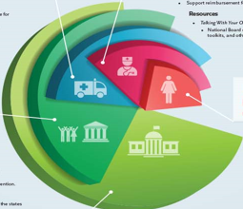
Social Model: Future Directions
Improve access to oral health care
Identify and target socially isolated seniors
Quantify prevalence of senior hunger and impact of home- and community-based interventions on its reduction
Increase access to culturally-diverse meal choices
Division of Aging Services

Slide 25

Summary
Malnutrition is diagnosed as prevalence of 2 or more standardized characteristics
Malnutrition can be a result of acute illness, chronic illness, or social/environmental factors
Current statistics suggest disease-associated malnutrition costs $51.3 billion annually
Malnutrition challenges can be addressed via a 5-level social model
The Facts Behind Senior Hunger: Updated for 2019. (2019, February 06). https://www.aginginplace.org/the-facts-behind-senior-hunger/
Division of Aging Services

Slide 26

Questions?
Renae Brown, MS, RD, LD Allison Bernal, RD, LD
Renae.brown1@dhs.ga.gov Allison.Bernal@dhs.ga.gov
This Photo by Unknown Author is licensed under CC BY-ND
Division of Aging Services

