Slide 1
Dementia Live
Evoking change through empowering experiences
Laura Ellen Christian, SVP of Engagement & Dementia Training
Susan Robbins, Regional Director of Dementia Training
Ann Germany, Area External Business Director

Slide 2
How are you feeling?

Slide 3
Dementia Tip Guide

Slide 4
47 DL Coaches Trained
175+ staff through DL Experience
80 Engagement and Maintenance Directors used DL to experience challenges of residents on buses
150+ community members (caregivers, professionals, first responders) through DL Experience
DL in rolling suitcases for easy access
Dementia Live in Action

Slide 5
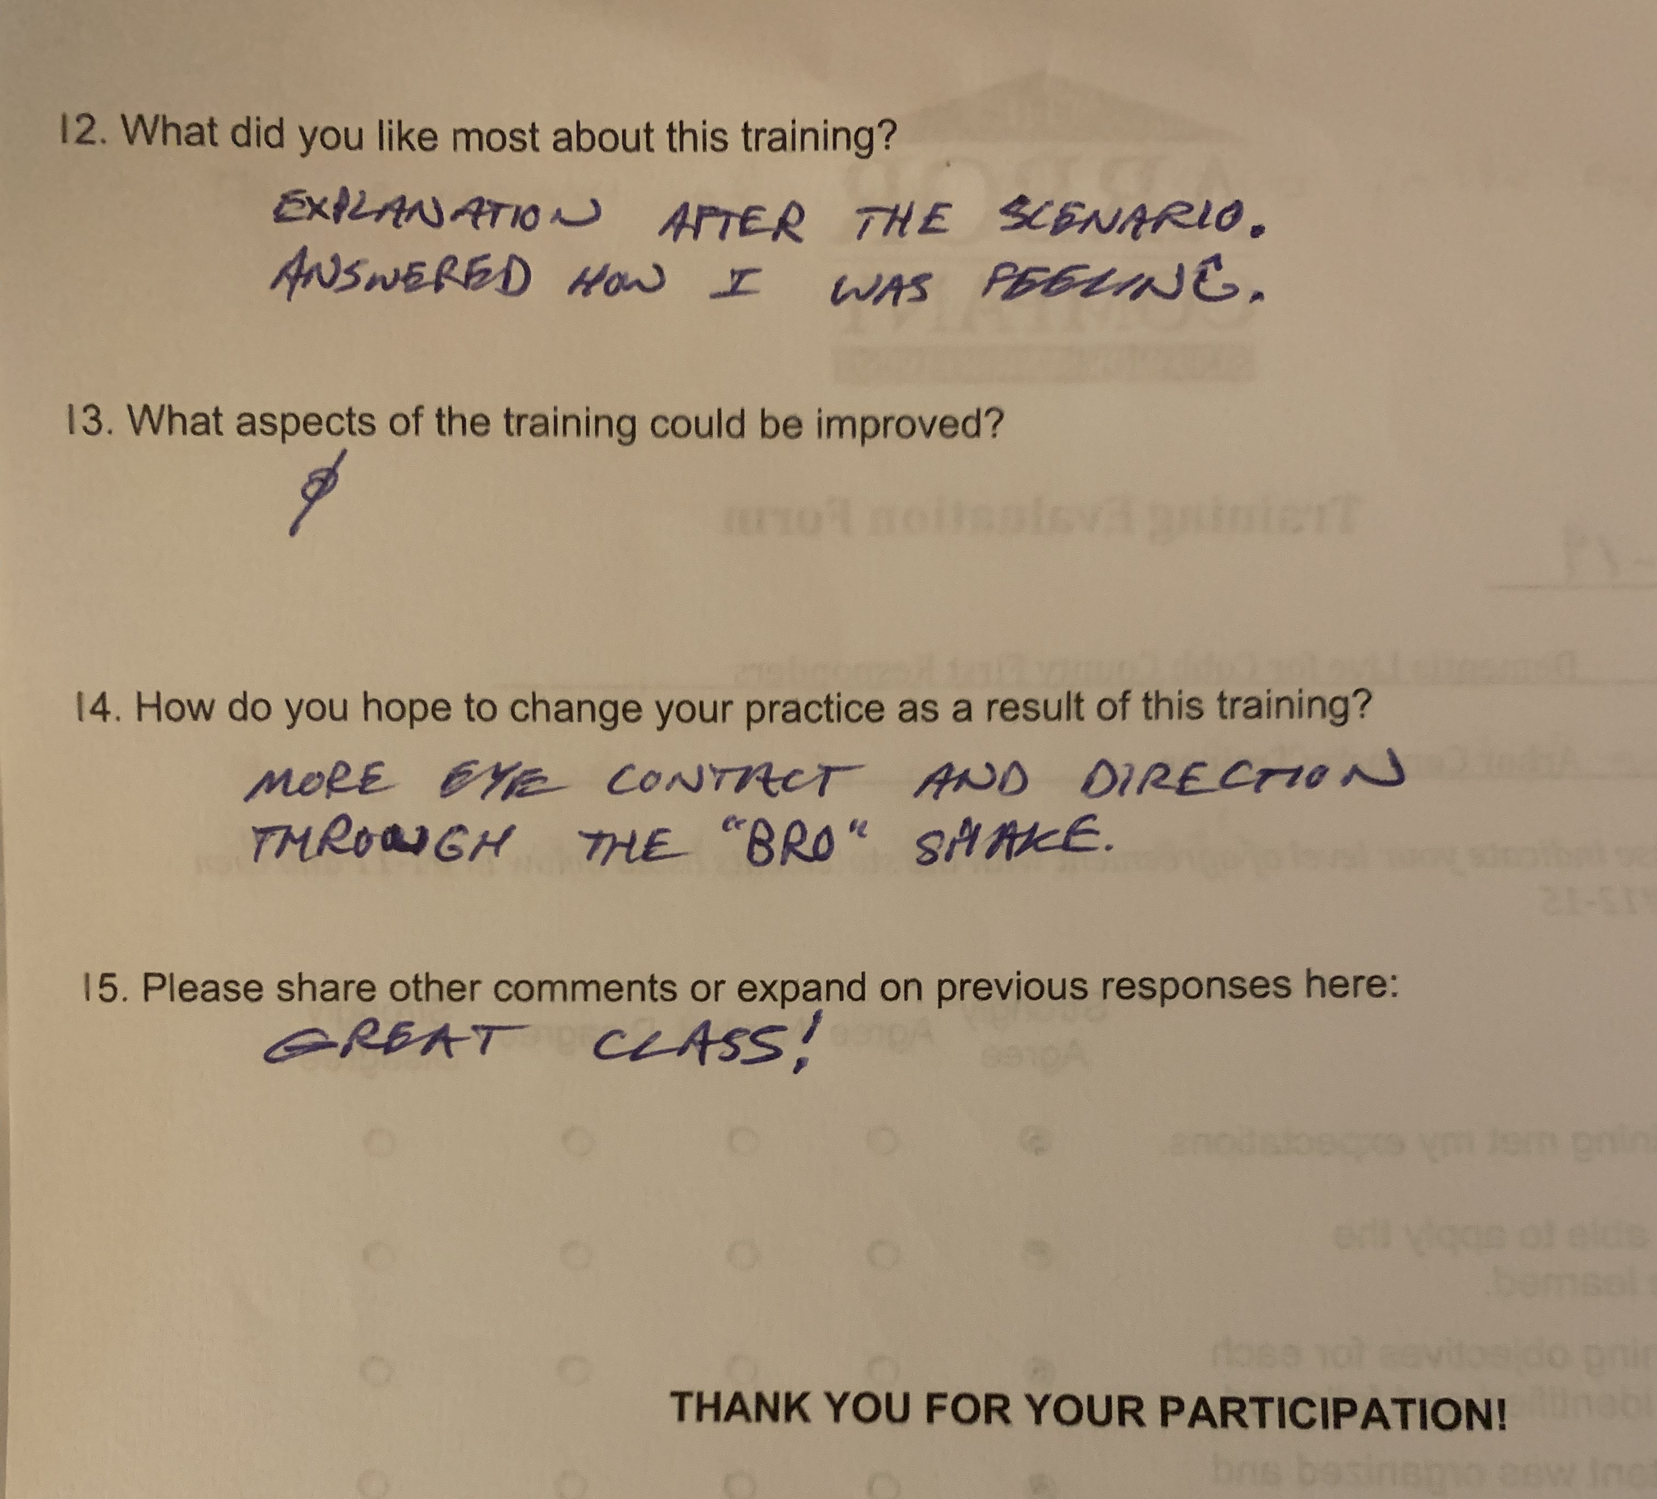

Slide 6
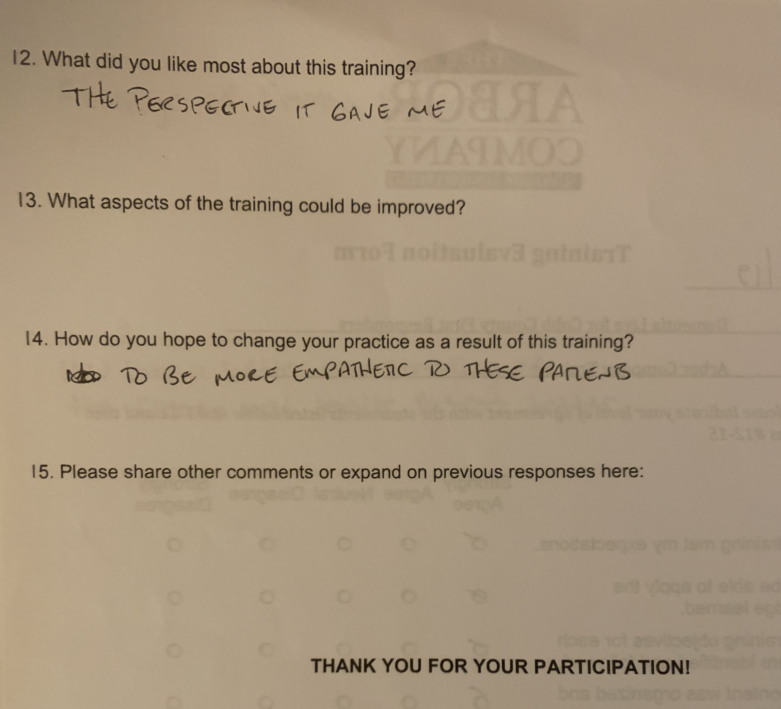

Slide 7
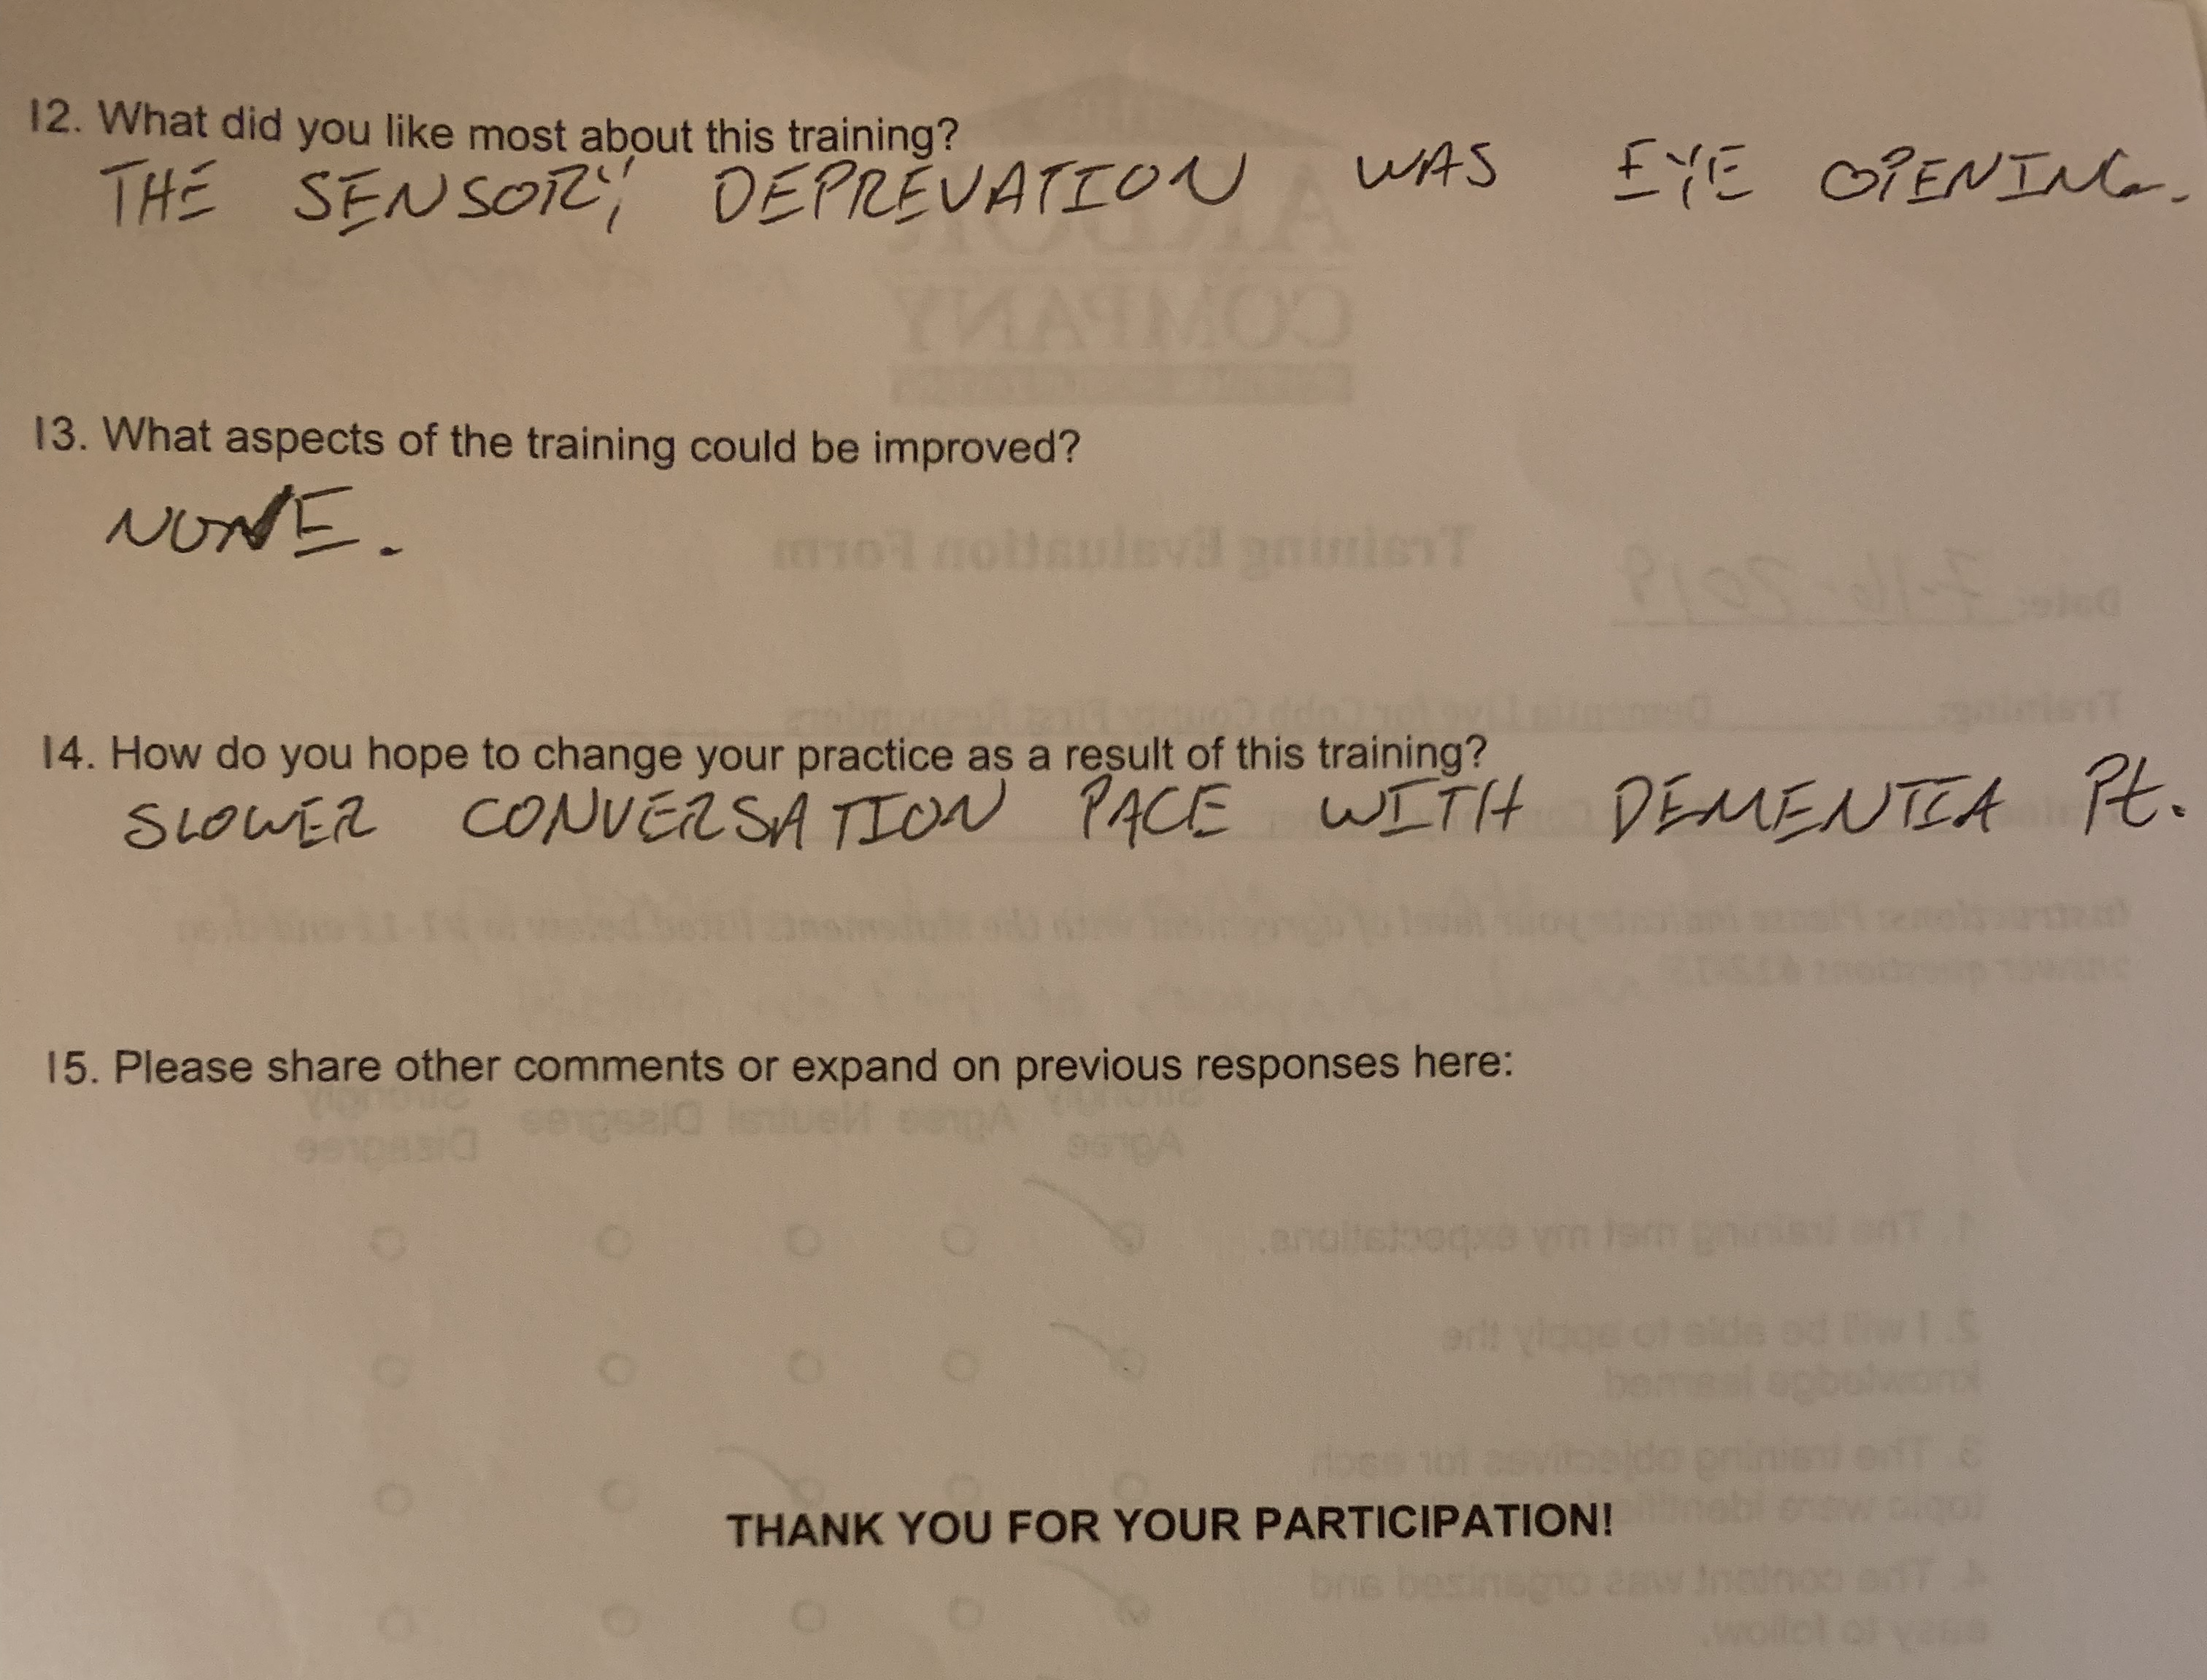

Slide 8
Thank you!
QUESTIONS?

